Slide 1
Sistem Klien Server Pertemuan – 2
Development process for an Android app

Slide 2

What Is Android?
Android is an operating system for mobile devices such as smartphones and tablet computers. It is developed by the Open Handset Alliance led by Google.
Android has beaten Apple iOS, being the leading mobile operating system from first quarter of 2011

Slide 3
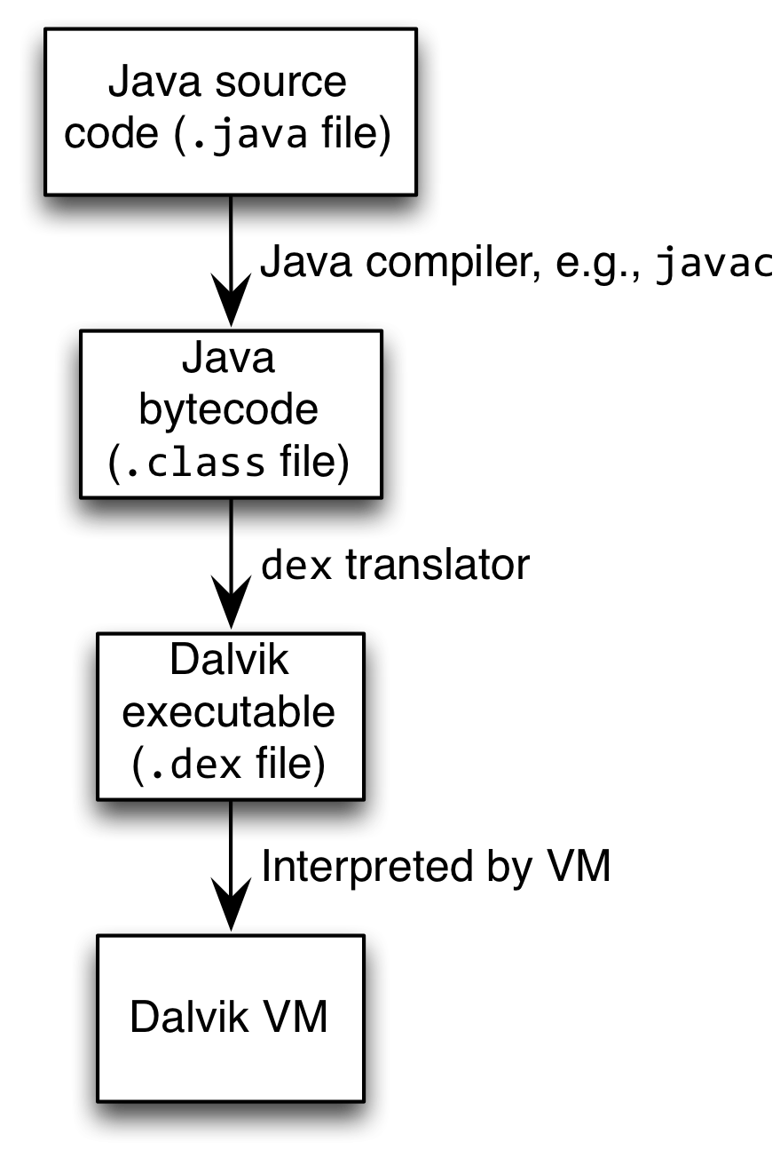
Android Highlights (1)
Android apps execute on Dalvik VM, a “clean-room” implementation of JVM
Dalvik optimized for efficient execution
Dalvik: register-based VM, unlike Oracle’s stack-based JVM
Java .class bytecode translated to Dalvik EXecutable (DEX) bytecode, which Dalvik interprets

Slide 4
Dalvik Java Virtual Machine (JVM)
Java Source
Code
Java Source
Code
Java Standard Edition
Java
Compiler
Java
Compiler
Java Byte
Code
Java Byte
Code
Dex
Compiler
Stack-based
byte-code
Dalvik Byte
Code
Register-based
byte-code
Java Virtual Machine (JVM)
Dalvik Virtual Machine (VM)

Slide 5

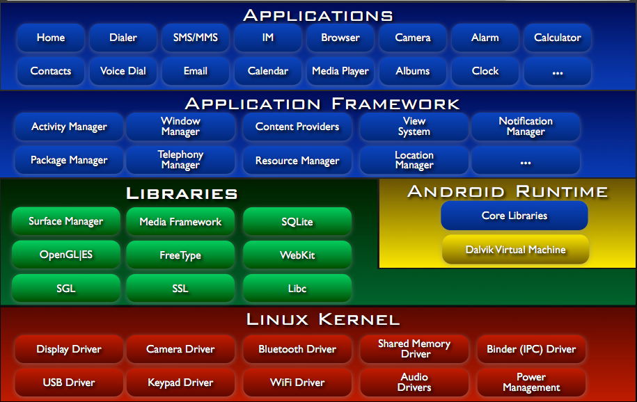
Android Architecture

Slide 6
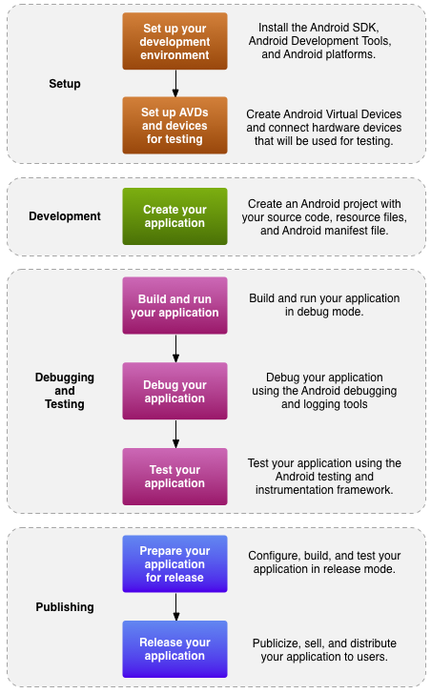
Development process for an Android app

Slide 7
Getting Started (1)
Need to install Java Development Kit (JDK) to write Java (and Android) programs
After installing JDK, download Android SDK from http://developer.android.com
Simplest: download and install Android Studio bundle (including Android SDK) for your OS
Alternatives:
Download/install Android Developer Tools from this site (based on Eclipse)
Install Android SDK tools by themselves, then install ADT for Eclipse separately (from this site)

Slide 8
Getting Started (2)
Strongly recommend testing with real Android device
Android emulator: very slow
Faster emulator: Genymotion
Install USB drivers for your Android device!

Slide 9
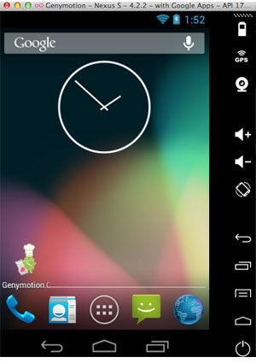


Slide 10




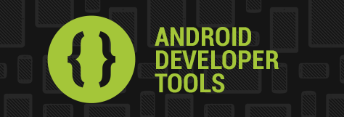
Setup - Tools

Slide 11
Now you’re ready for Android development!

Slide 12
Android Development
Apps use four main components:
Activity: A “single screen” that’s visible to user
Service: Long-running background “part” of app (not separate process or thread)
ContentProvider: Manages app data (usually stored in database) and data access for queries
BroadcastReceiver: Component that listens for particular Android system “events”, e.g., “found wireless device”, and responds accordingly

Slide 13
Android Components: Activities
An Activity corresponds to a single screen of the Application.
An Application can be composed of multiples screens (Activities).
The Home Activity is shown when the user launches an application.
Different activities can exhange information one with each other.
Hello World!
Android HelloWorld
Button1

Slide 14
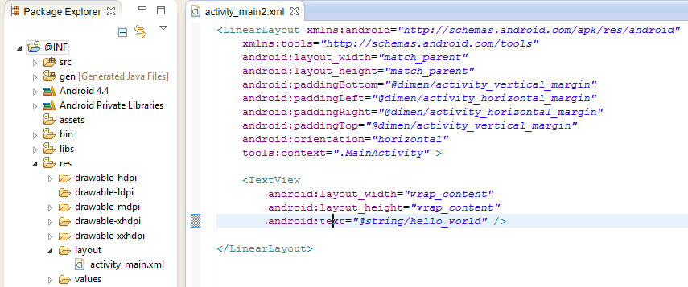
Layout in Android
An XML‐based layout is a specification of the various UI components (widgets) and the relationships to each other –and to their containers –all written in XML format.
res/layout

Slide 15
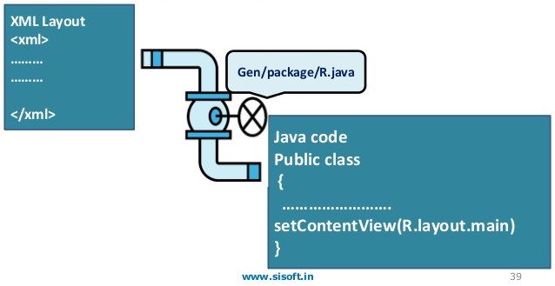
Attaching Layouts to Java Code → XML to Java
public class Main extends Activity {
protected void onCreate(Bundle savedInstanceState) {
super.onCreate(savedInstanceState);
setContentView(R.layout.main);
}
}

Slide 16
Attaching Layouts to Java Code - 2
Main.java
public class Main extends Activity {
protected void onCreate(Bundle savedInstanceState) {
super.onCreate(savedInstanceState);
setContentView(R.layout.main);
}
}
R.java
public static final class layout {
public static final int main=0x7f030000;
}

Slide 17
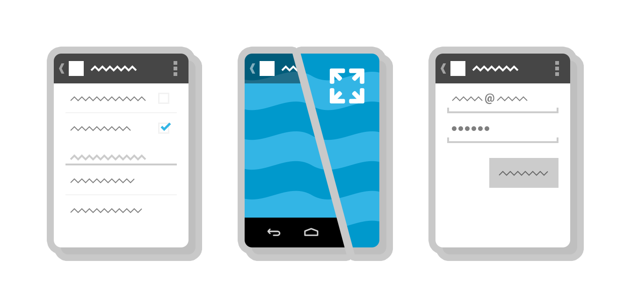
App behavior in Java
An Activity is an application component that provides a screen with which users can interact in order to do something, such as dial the phone, take a photo, send an email, or view a map.
Activity
Each activity is given a window in which to draw its user interface in xml layout.

Slide 18
Variable in Layout → XML to XML
Main.xml
<TextView
android:id="@+id/TextView1"
android:layout_width="wrap_content"
android:layout_height="wrap_content"
android:text="@string/hello_world“
/>
Strings.xml
<resources>
<string name="app_name">AKDip</string>
<string name="action_settings">Settings</string>
<string name="hello_world">Hello world!</string>
</resources>

Slide 19
Variable in Activity from Layout → XML to Java (Ex. TextView)
Main.java
protected void onCreate(Bundle savedInstanceState) {
super.onCreate(savedInstanceState);
setContentView(R.layout.activity_main);
TextView tv = (TextView) findViewById(R.id.TextView1);
tv.setText("Hello new World");
}
R.java
public static final class id {
public static final int TextView1=0x7f080003;
}

Slide 20
Variable in Activity from Layout → XML to Java (Ex. Button)
Main.xml
<Button
android:id="@+id/button1"
android:layout_width="wrap_content"
android:layout_height="wrap_content"
android:text="@string/tombol“
android:onClick=“saatTombolDitekan”
/>
Main.java
public void saatTombolDitekan(View v) {
Button bt = (Button) findViewById(R.id.button1);
bt.setText("Hello new World");
}

Slide 21
Main.java
Button btn = (Button) findViewById(R.id.button1);
btn.setOnClickListener(new View.OnClickListener() {
@Override
public void onClick(View v) {
btn.setText(“Hello”);
}
});

Slide 22
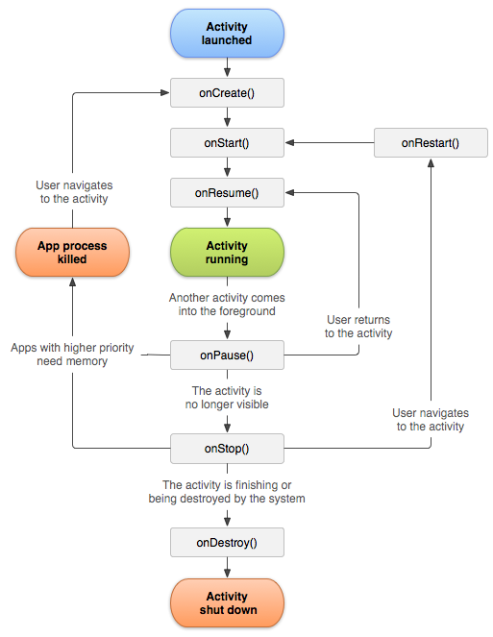
Android Activity Lifecycle

Slide 23
onCreate() → Called when the activity is first created. This is where you should do all of your normal static set up create views, bind data to lists, and so on.
onStart() → Called just before the activity becomes visible to the user.
onRestart() → Called after the activity has been stopped, just prior to it being started again.
onResume() → Called just before the activity starts interacting with the user.
onPause() → Called when the system is about to start resuming another activity.
onStop() → Called when the activity is no longer visible to the user.
onDestroy() → Called before the activity is destroyed.
Source : http://developer.android.com/guide/components/activities.html

Slide 24
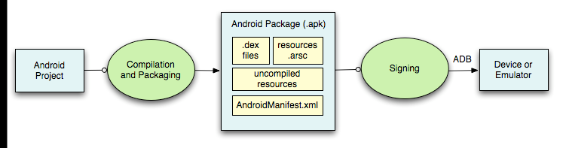
Debug and Testing
ADB is a client server program that connects clients on developer machine to devices/emulators to facilitate development.
An IDE like Eclipse handles this entire process for you.

Slide 25
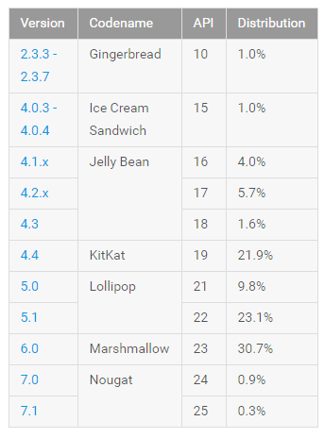
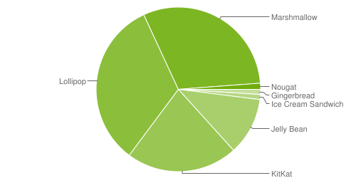
Distribution of Devices
http://developer.android.com/about/dashboards/index.html

Slide 26
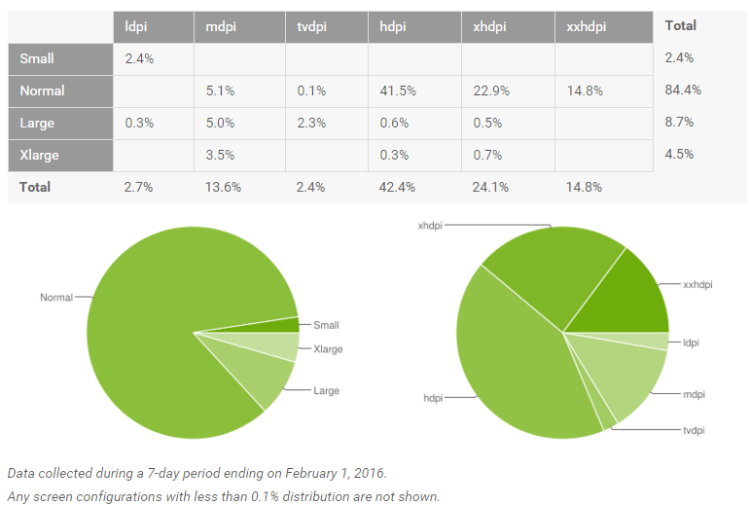
http://developer.android.com/guide/practices/screens_support.html

Slide 27
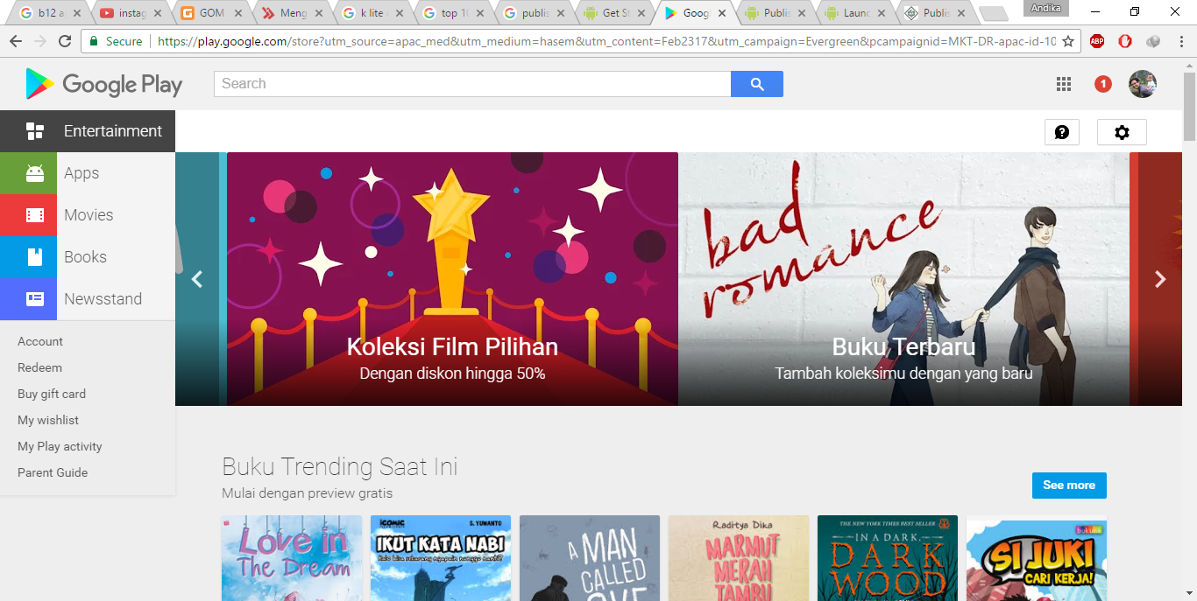
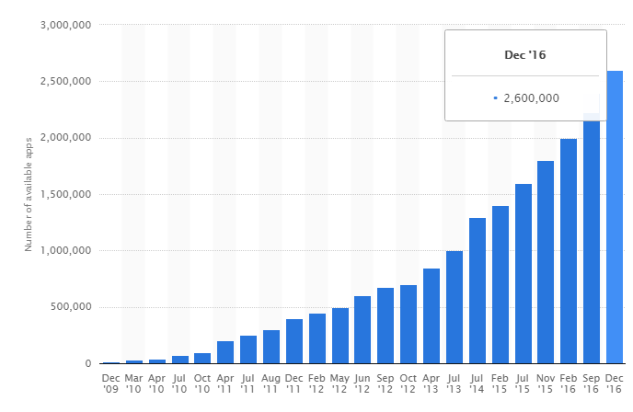
Publishing
2,6 million apps
Source : http://www.statista.com/statistics/266210/number-of-available-applications-in-the-google-play-store/

Slide 28
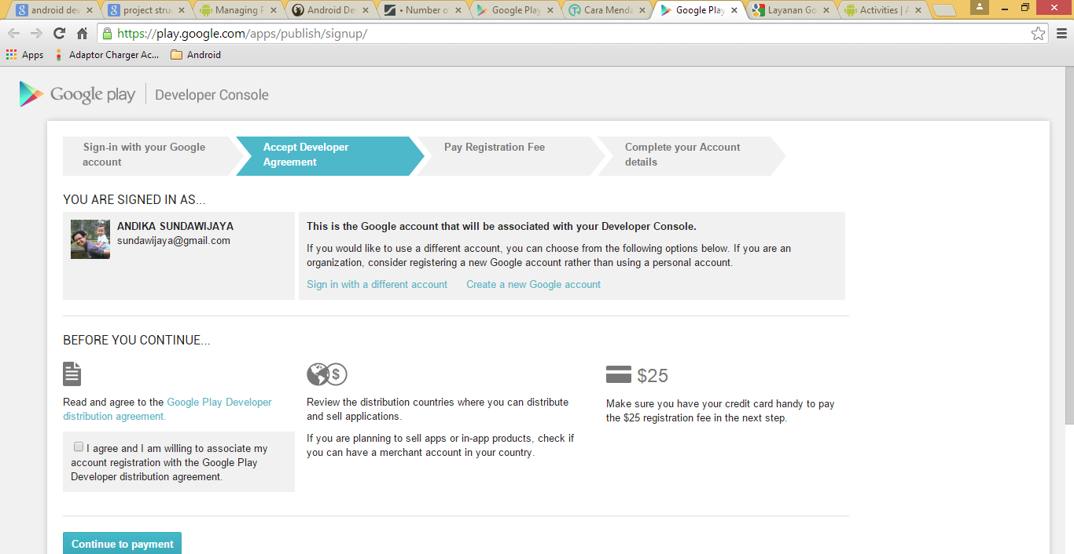
Registration on Google Play
play.google.com/apps/publish

Slide 29
Thank you
Andika Sundawijaya
sundawijaya@gmail.com

